Slide 1
AUTOMATED LIGHTING CONTROL USING HUMAN EMOTIONS
ASHWINI KUMAR RAY

Slide 2
HARDWARE COMPONENTS
WEBCAM
ESP 32
4 CHANNEL RELAY MODULE
9 V BATTERY
LEDs
BREADBOARD

Slide 3
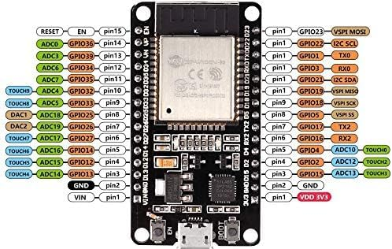
ESP 32
Product: IoT Development Board
Model: ESP32-WROOM-32U
CPU: Xtensa dual-core 32-bit LX6 microprocessor
Voltage: 3.6V
Current: 500mA
Frequency: 240 MHz

Slide 4
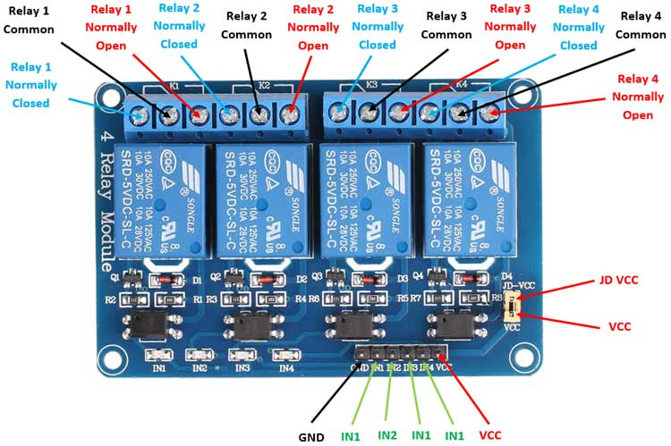
RELAY MODULE
Supply voltage – 3.75V to 6V
Trigger current – 5mA
Current when the relay is active - ~70mA (single), ~300mA (all four)
Relay maximum contact voltage – 250VAC, 30VDC
Relay maximum current – 10A

Slide 5
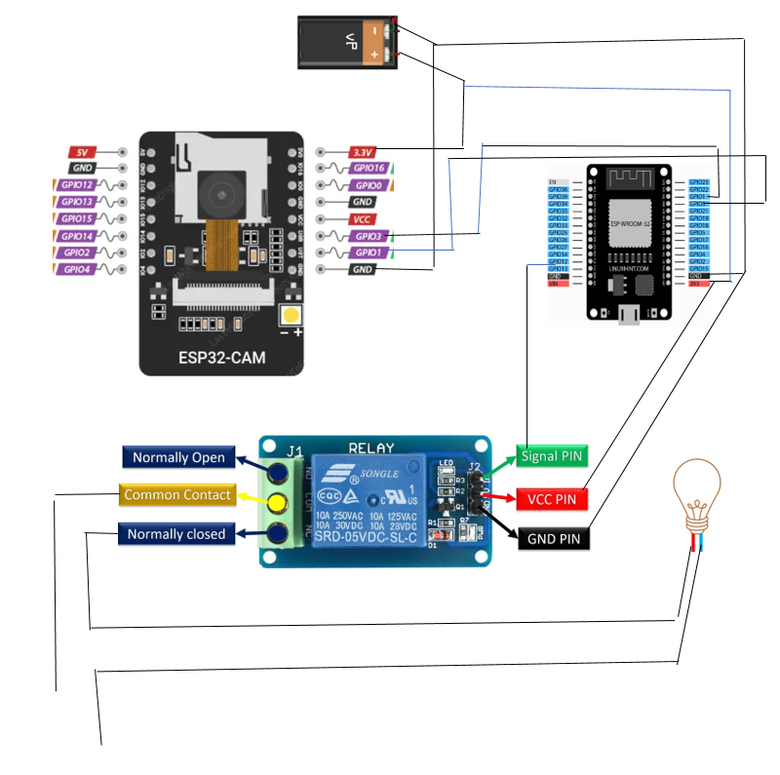
ARCHITECTURE DIAGRAM

Slide 6
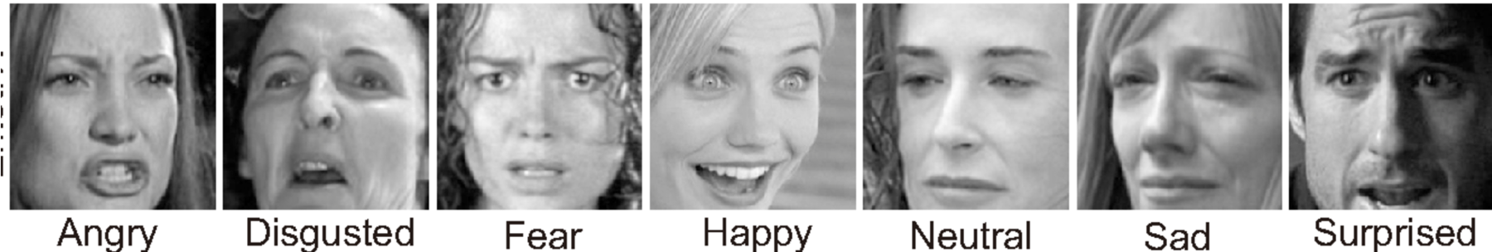
ABOUT THE DATASET
FER-2013
The data consists of 48x48 pixel grayscale images of faces.
The task is to categorize each face based on the emotion shown in the facial expression into one of seven categories (0=Angry, 1=Disgust, 2=Fear, 3=Happy, 4=Sad, 5=Surprise, 6=Neutral). The training set consists of 28,709 examples and the public test set consists of 3,589 examples.

Slide 7
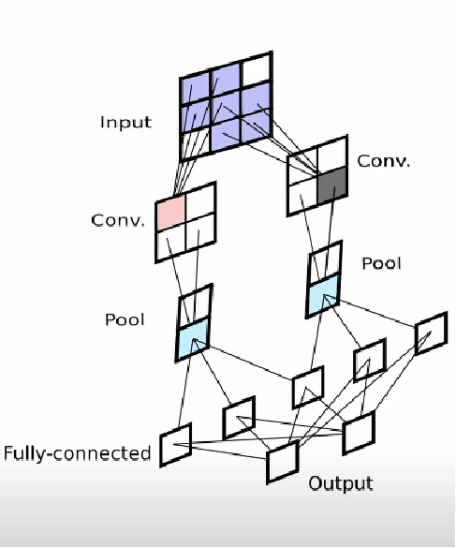
ALGORITHM USED
CNN: Convolutional Neural Network
Convolutional Layer
Pooling Layer
Fully Connected Layer

Slide 8
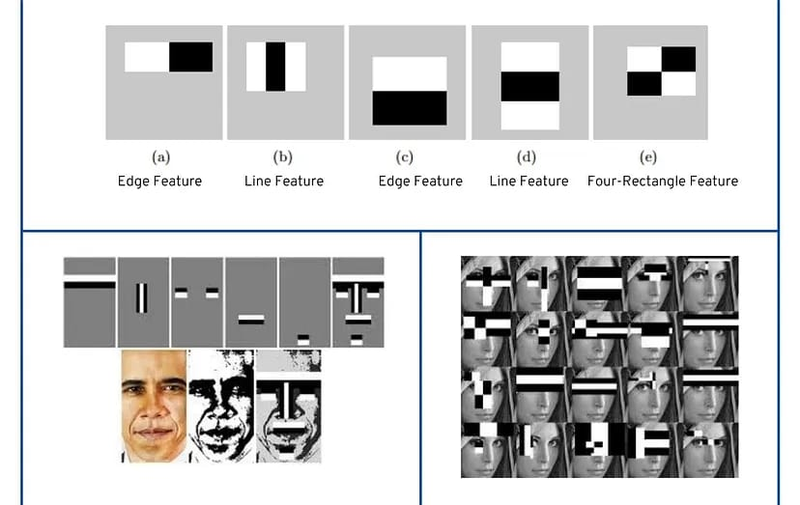
HAAR CASCADE CLASSIFIER:
Haar Cascade is an object detection algorithm used to identify specific objects (like faces) in images or videos.At each position, the algorithm checks if certain features (Haar-like features) match a predefined pattern.

Slide 9

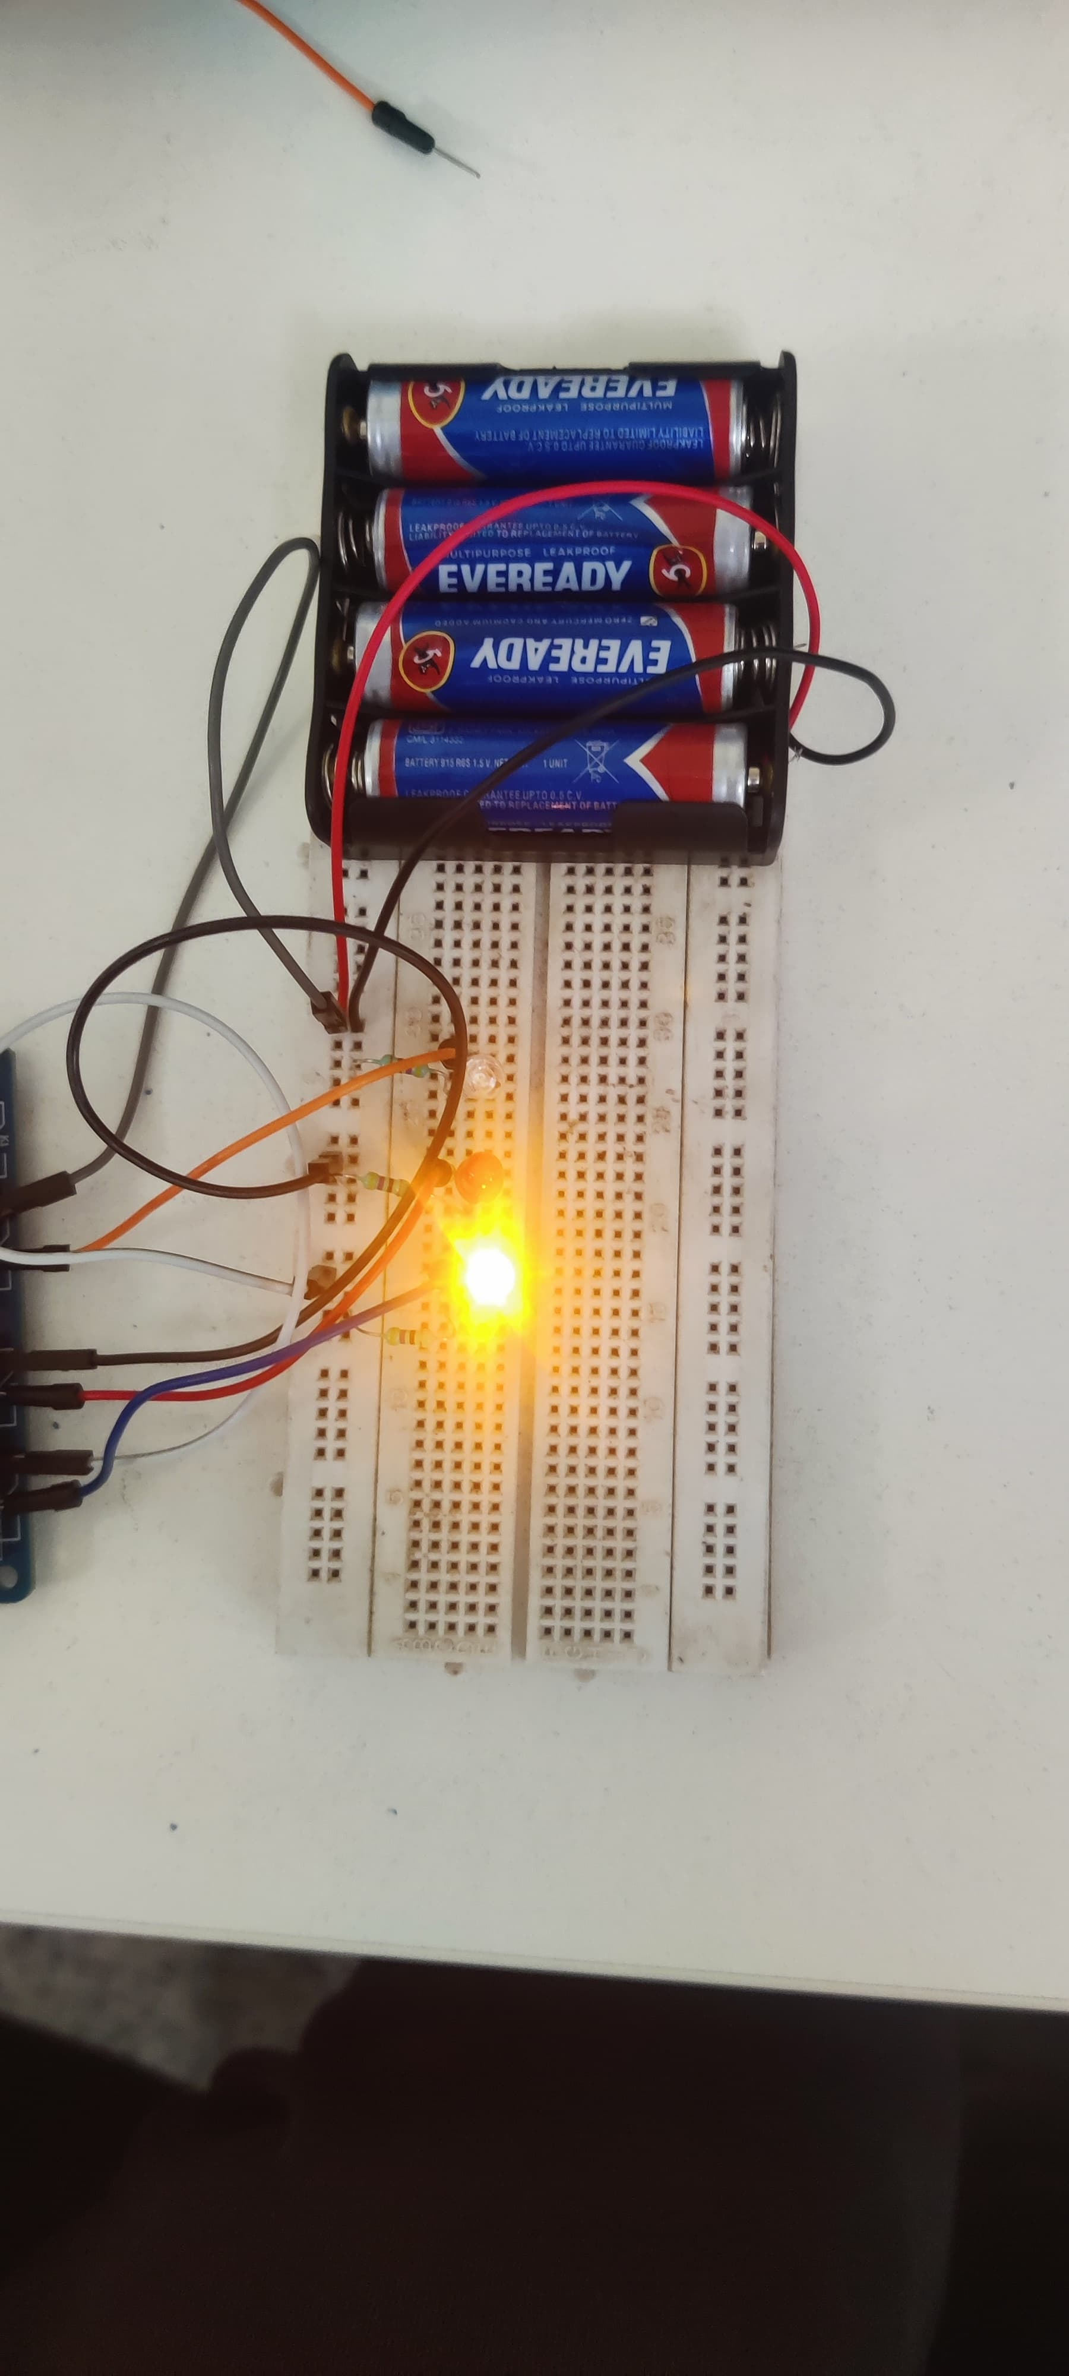

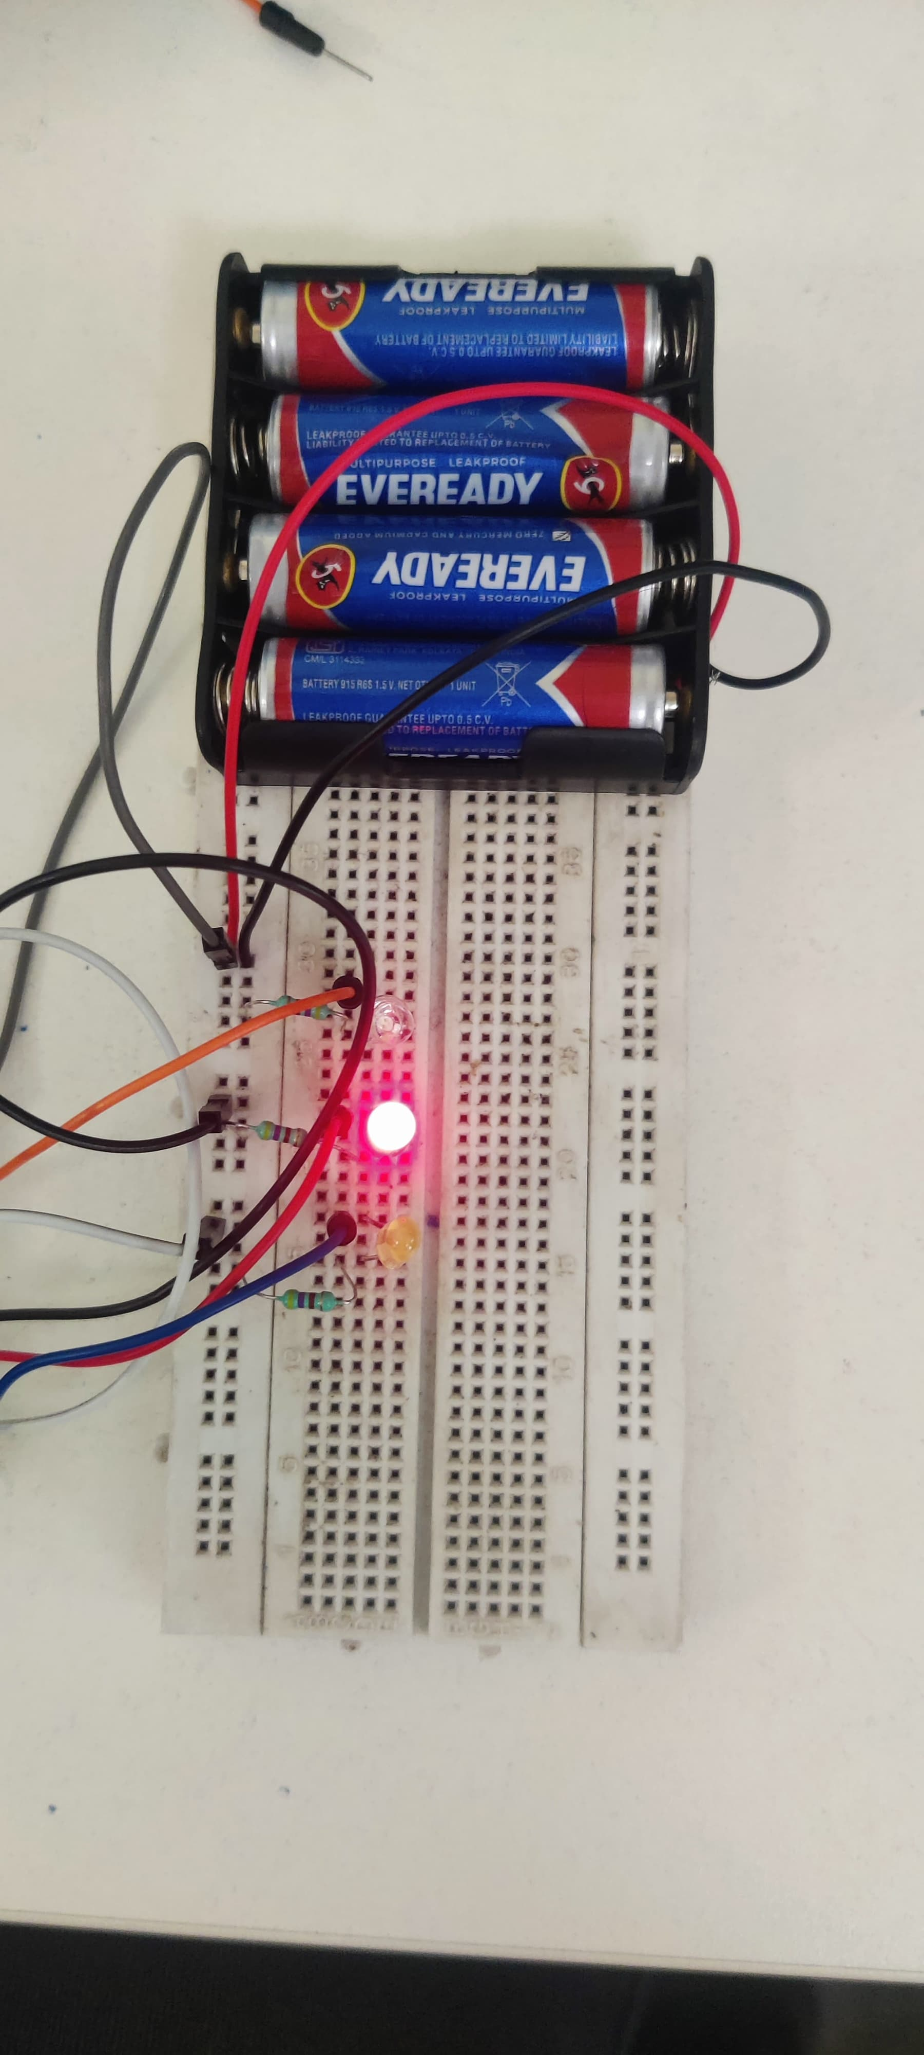

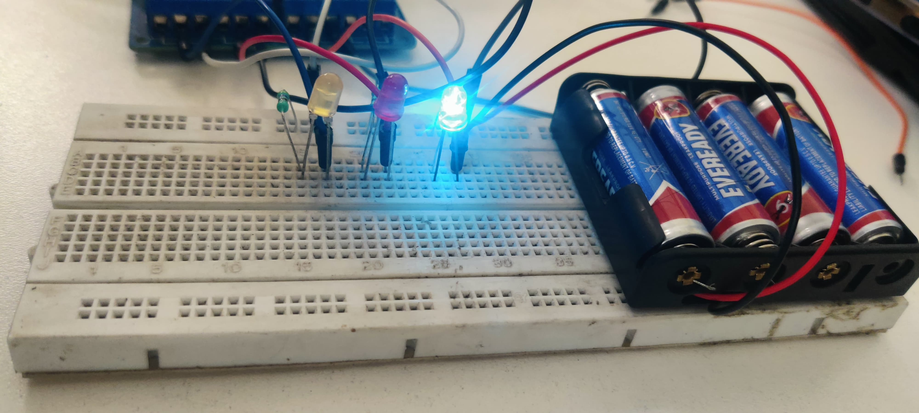
RESULT

